Slide 1
PREDICTIVE TEXT FOR CONTEXT ANALYZATION
Gadicherla Sameer 01FB15ECS101
G Manasa
01FB15ECS099
UE15CS333 project submission

Slide 2
SUBMISSION GUIDELINES
Since ESA time table in preponed (starting on 9th May), last date of submission is 6th May 2018 (Sunday) EOD. No extension will be granted.
Dataset, working ipython notebook and this presentation have to be submitted as a zip file (only one zip file per team). Name the zip file appropriately. You can either upload in Google drive or mail to bhaskarjyoti01@gmail.com
The final marks awarded by the evaluator will be based on the following factors.
Working code that delivers result : 12
Visualization, metric, comparison : 3
Nature of dataset : 2
Novelty of idea / publishability if completed : 3

Slide 3
ABOUT THE PROJECT
Project idea: To create a system which, given input as a part of a complete English sentence, can predict the next word in the sentence or generate the next sequence of words using Markov Chains and RNNs.
Why you think this can be turned into a publishable work:
This can be turned into a publishable work because analyzing the context of any text for a given situation is done unbiased without any human intervention. Usually this is done character by character but we are doing it word by word , which implies the dependency on previous words is captured than the previous character, which helps in remembering the context better because we train the RNN on the words directly. We will use this model in future to predict musical compositions of a particular singer.(This can be acheived even by training it on note by note in music as character by character)

Slide 4
LITERATURE SURVEY AND EXISTING WORK
Serial No | Title, author, web URL (if any) | What was useful as a reference
1 | https://en.wikipedia.org/wiki/Language_model | We came to know what language models are exactly
2 | https://en.wikipedia.org/wiki/Markov_property | Markovian property
3 | https://en.wikipedia.org/wiki/Markov_chain | Markov chains
4 | https://en.wikipedia.org/wiki/Recurrent_neural_network | RNN basics
5 | Bengio, Yoshua, Simard, Patrice, and Frasconi, Paolo. Learning long-term dependencies with gradient descent is difficult. Neural Networks, IEEE Transactions on, 5(2):157–166, 1994. | Short term memory to train gradient descent
6 | Dauphin, Yann N, de Vries, Harm, Chung, Junyoung, and Bengio, Yoshua. Rmsprop and equilibrated adaptive learning rates for non-convex optimization. arXiv preprint arXiv:1502.04390, 2015. | Rmsprop optimization though we used adam
7 | Graves, Alex. Generating sequences with recurrent neural networks. arXiv preprint arXiv:1308.0850, 2013. | Basic idea on how to generate sequences
8 | http://cs229.stanford.edu/proj2015/054_report.pdf | Adam optimization and normalizations

Slide 5
DATASET SOURCE AND PREPROCESSING DONE
Dataset source :
For markov chains :
Corpus of Contemporary American English (COCA) from here
About Dataset: The Corpus of Contemporary American English (COCA) is the largest freely-available corpus of English, and the only large and balanced corpus of American English.
Attributes: We will be using a subset of COCA mainly from here. Hence, we will be using two, three, four and five-gram inputs to train the model each time.
Instance count: Each of the n-gram datasets contains the following number of n-grams:
2-gram: 1,020,386
3-gram: 1,020,010
4-gram: 1,034,308
5-gram: 1,044,269
This was the primary dataset for testing the goodness of fit for every other dataset as it was exhaustive. We also trained using this dataset for next-word prediction as well as generating text.

Slide 6
a
Wikipedia Corpus
About dataset: This corpus contains the full text of Wikipedia, and it contains 1.9 billion words in more than 4.4 million articles.
Attributes: Wikipedia Corpus contains Wikipedia pages scraped and dumped into text files. Since it is only for testing, we used random articles with a total of 2286765 words.
RNN and LSTM:
Narendra Modi speech in US : This has around 1000+ lines and is taken from a news website
Narendra Modi speech on gst: This has around 2500+ lines and is also taken from a blog on web.
Harry Potter Novel : It is the first book of the Harry potter series with has around 7000 lines and is has around 57 distinct words.

Slide 7
DATASET SOURCE AND PREPROCESSING DONE(Cont.)
Pre-processing steps performed
Wikipedia Corpus:
Read all the lines of the input file.
Remove all unwanted characters and punctuations.
Remove lines with very few words.
Convert everything to lower-case.
Run a sliding window on the words
Narendra Modi Speeches:
Same as for Wikipedia but further,
Distinct number of words are found
All words are represented as numbers
All sentences are represented as a sequence of numbers
All the sequences are padded to the largest sequence size wth zeroes

Slide 8
MARKOV CHAINS

Slide 9
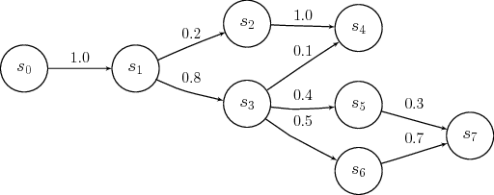
HIGH LEVEL DESIGN OF OUR IMPLEMENTATION
MARKOV CHAIN APPROACH:
We create the training set by creating (n-gram , n+1 word , count ) pairs and save these pairs in the SQL database
Then as said in pre-processing we also use the Wikipedia corpus, run. A sliding window and save the input,output pairs , which can also be used as training dataset but we are just using to test our model
So , in order to predict the next word , we give a simple SQL query to the database and return an ordered dictionary of word , count pairs which the client.py file will help us calculate the probability(if needed).
We have used the databse approach just because , it is very fast compared to vanilla lists , and practically impossible when the size of the text moves into GBs.
Note : Both the dataset and latest jupyter notebook ( python 3.0) have to be submitted for evaluation

Slide 10
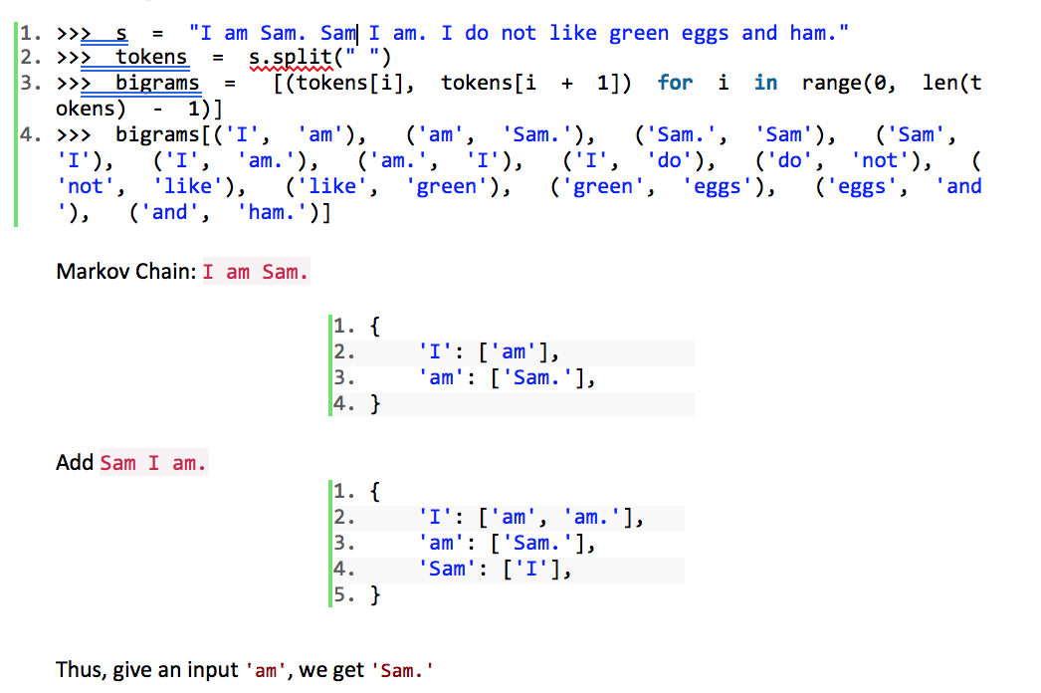
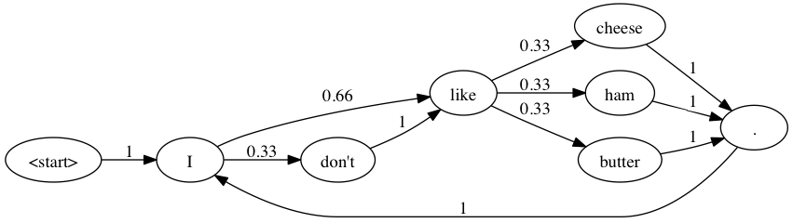
PSEUDO-CODE
Create bi-grams:
Figure 2 An example of fully modeled Markov Chain

Slide 11
RNN AND LSTM

Slide 12
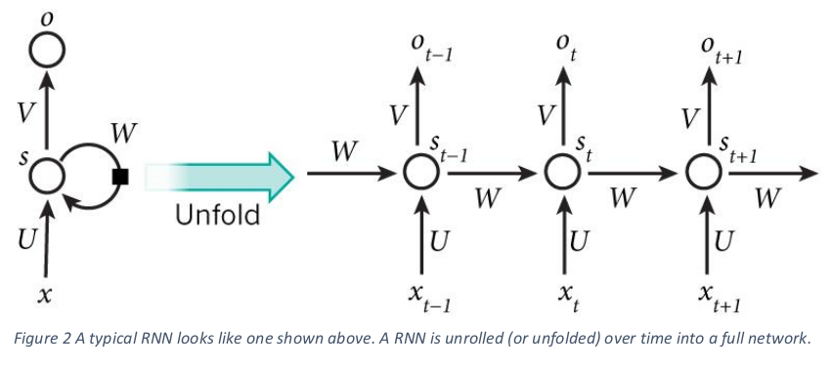
RNN basics
RNNs make use of sequential information. A traditional neural network assumes that all inputs (and outputs) are independent of each other.
Since our project is to predict text, it is crucial to know the information from previous states, i.e. the previous words to predict the next word.
RNNs are called recurrent because they perform the same task for every element of a sequence, with the output depending on the previous computations.
RNNs thus have a “memory” element to capture information from previous calculations.

Slide 13
Need for LSTM and its advantages over RNN:
Two major problems with RNN: Vanishing and Exploding gradients.
Vanishing Gradients: In traditional RNNs the gradient signal can be multiplied a large number of times by the weight matrix. Thus, the magnitude of the weights of the transition matrix can play an important role. If the weights in the matrix are small, the gradient signal becomes smaller at every training step, thus making learning very slow or completely stops it. This is called vanishing gradient.
Exploding Gradients: refers to the weights in this matrix being so large that it can cause learning to diverge.
LSTM stands for Long Short Term Memory, is a special kind of RNN that learns long-term dependencies. The memory cell of LSTM is composed of four elements: input, forget and output gates and a neuron that connects to itself.

Slide 14
CHARACTER MODEL

Slide 15
Design For the Character Model
In order to train our recurrent neural network, we use a large text file (we have used the Harry Potter books) as input. This large text file undergoes preprocessing and is stored in the form of two arrays X and Y defined as:
X: which is a three dimensional array of the form X[i, t, char_indices[char]] where i is the index of each sentence, t is the index of each letter in each sentence and char_indices[char] indicates the letter encountered. Therefore, X is like the given input matrix.
Y: which is a two dimensional array of the form Y[i, char_indices[next_chars[i]]] where i is the index of each sentence and char_indices[next_chars[i]] indicates the letter which is encountered after encountering SEQUENCE_LENGTH (set to 40) characters of the sentence. Therefore, Y is like the expected output matrix.
We iterate through the text file at a step size of 3 characters, scanning through all characters, till SEQUENCE_LENGTH (store in list of sentences) and storing the next expected character after SEQUENCE_LENGTH (store in list of next_char). This is then used in the creation of the X and Y matrices.

Slide 16
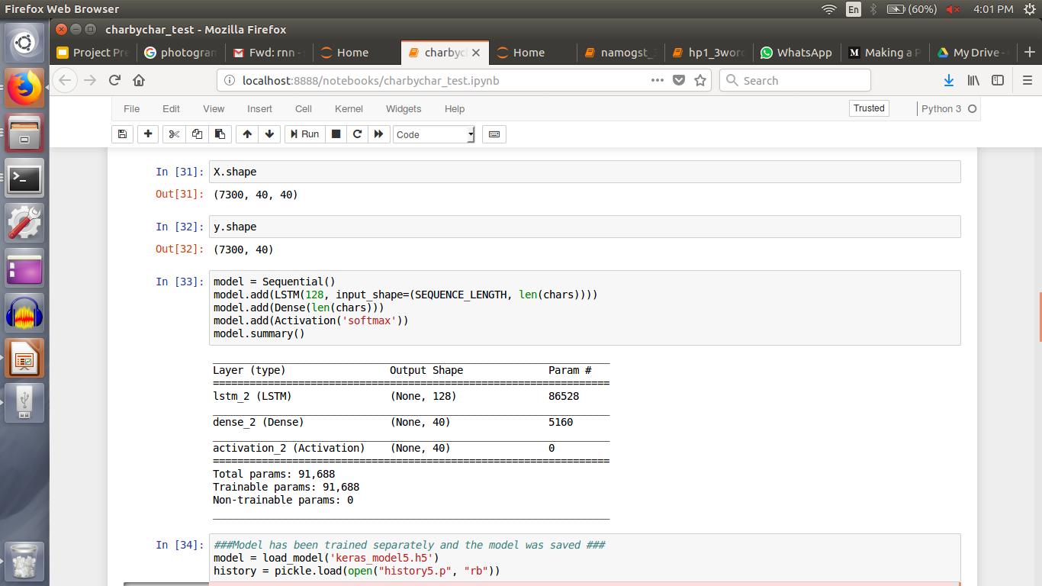
Model Architecture
We train the following model on the input format specified before:
Our model is trained for many number of epochs till 120 using RMSProp optimizer and uses 5% of the data for validation.

Slide 17
WORD BY WORD MODEL

Slide 18
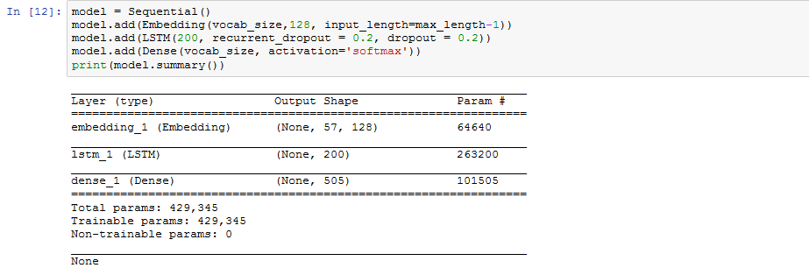
LSTM APPROACH FOR WORD BY WORD
After all the pre-processing as mentioned in the pre-processing slide.
Then we create a RNN model which is actually an LSTM preserved model with following architecture and train/use this with two approaches.

Slide 19

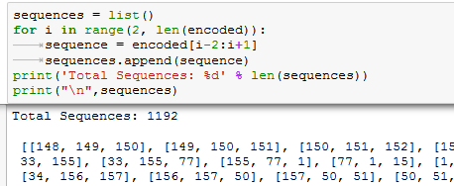
APPROACHES
1. Whole sentence is used as X (input) and the next word is the output (y). This approach is better than just the previous word. That is how the data to train is created.
2. In this approach we create the dataset , by training it as X which has the previous two words and the y has the next output word.

Slide 20
RESULTS

Slide 21
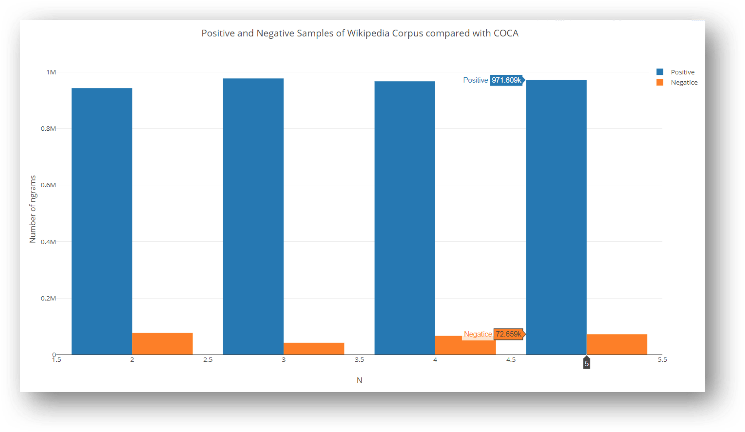
RESULTS, VISUALIZATION, METRIC
Markov Chain
Positive vs Negative samples of Wikipedia with COCA

Slide 22
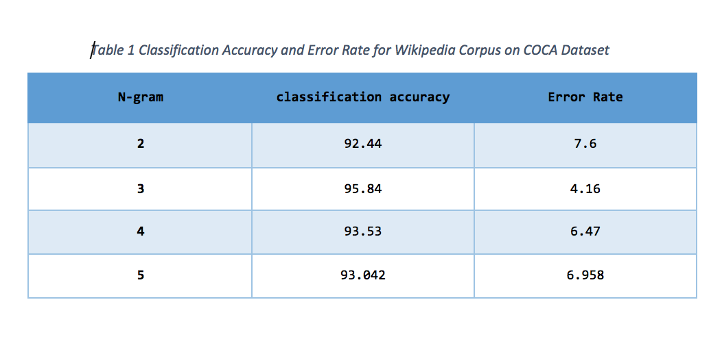
Coca tested over Wikipedia

Slide 23
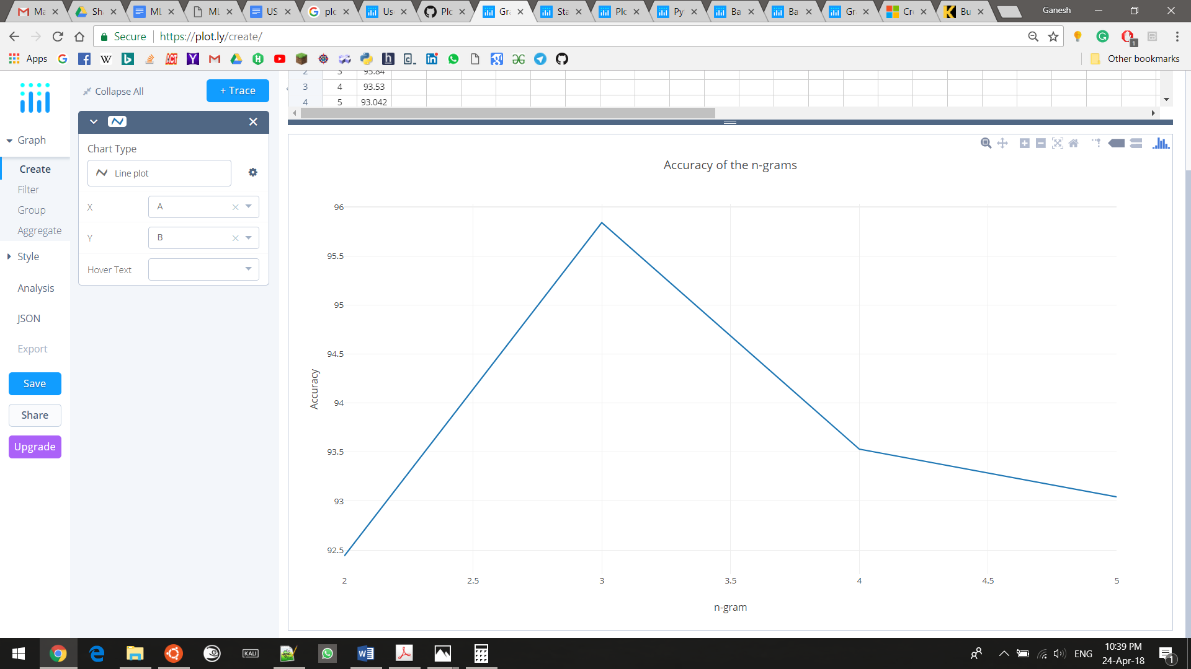
n-gram vs accuracy

Slide 24
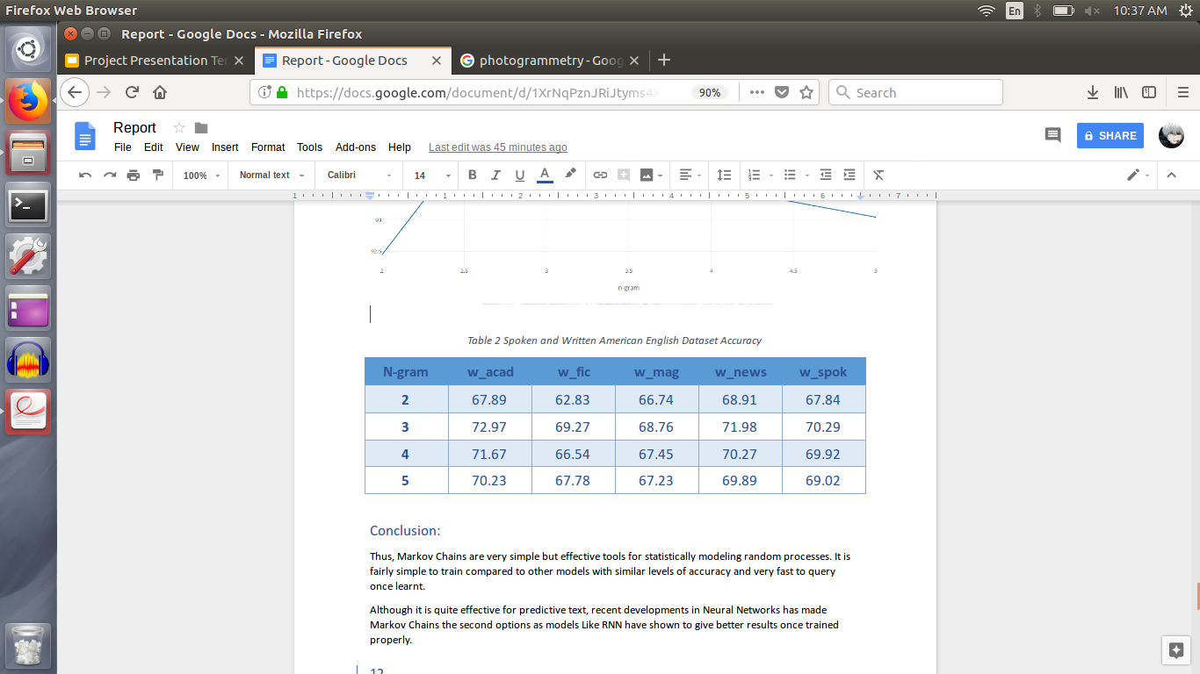
Spoken and Written American English dataset accuracy

Slide 25
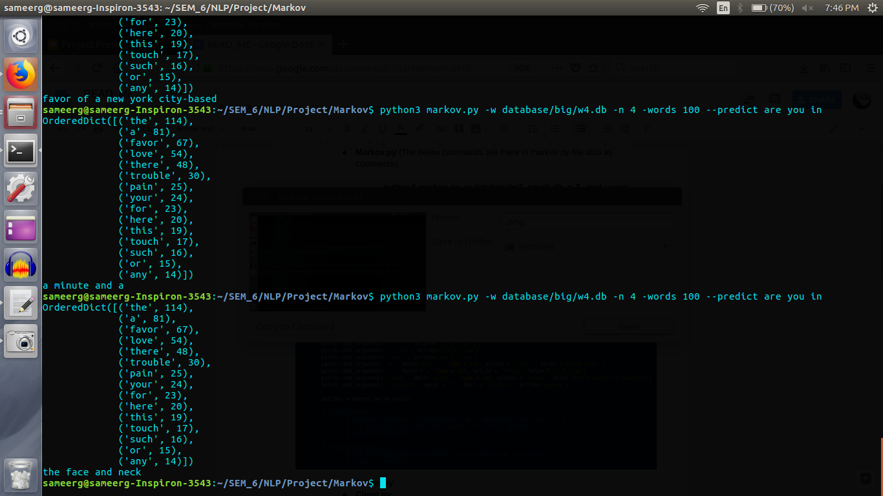

Slide 26
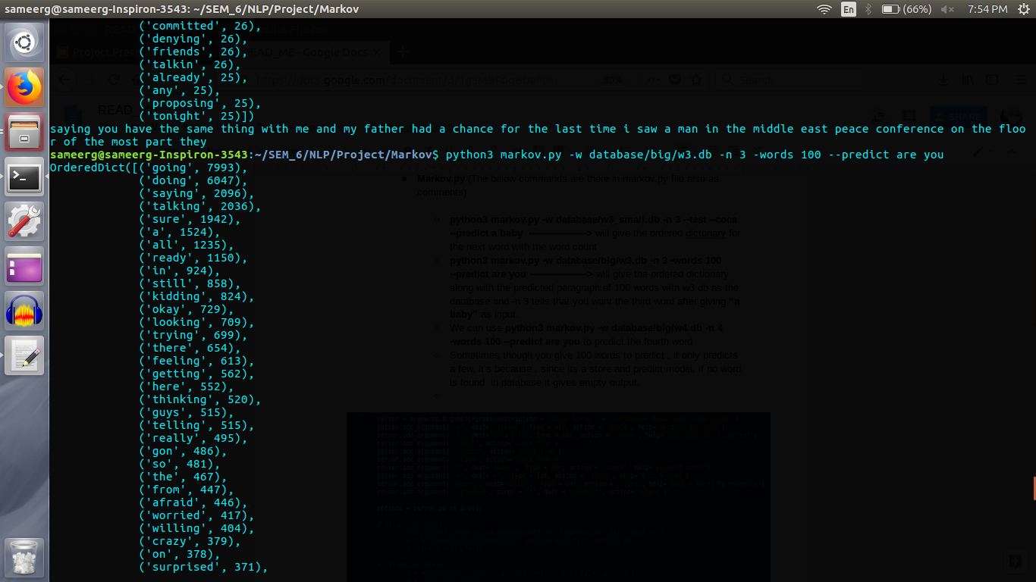
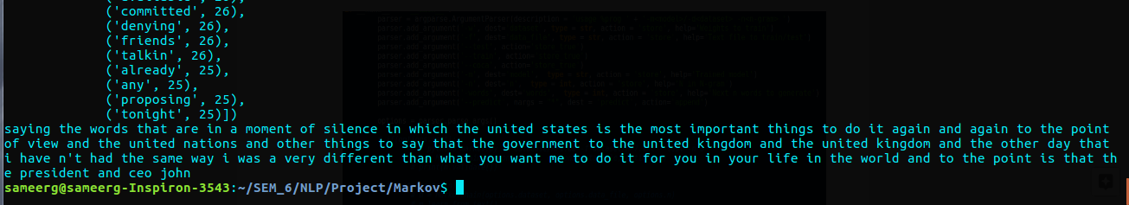
Outputs:
output for 100 words given a bigram , and trigram ,database w3.db is used, with starting by predicting the 3 gram , then last two words of the tri gram is used to predict the next 3-gram till 100 words are produced.

Slide 27
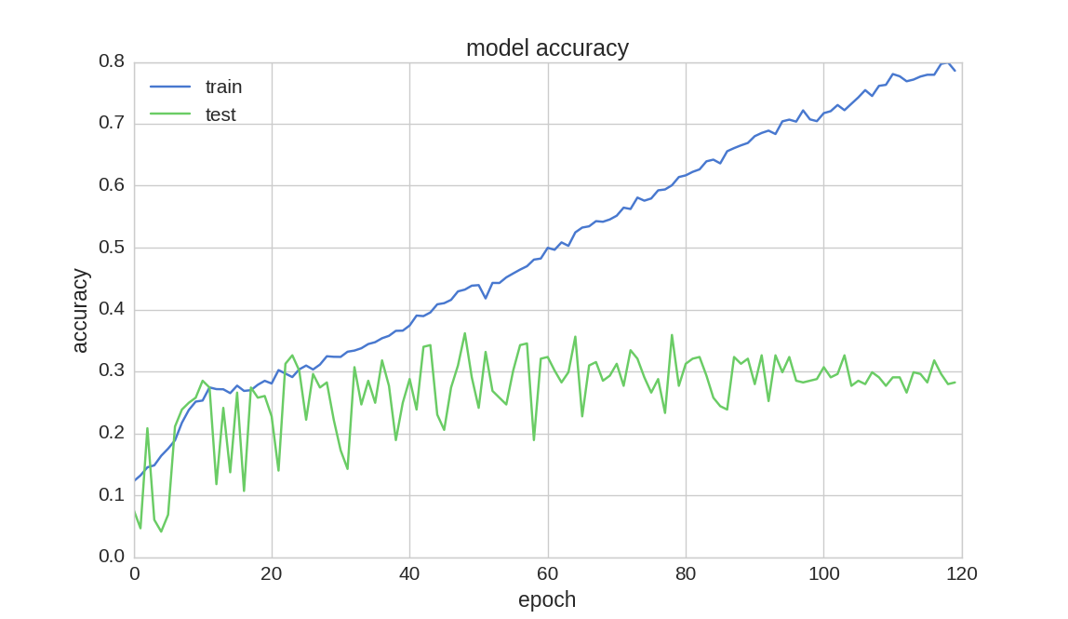
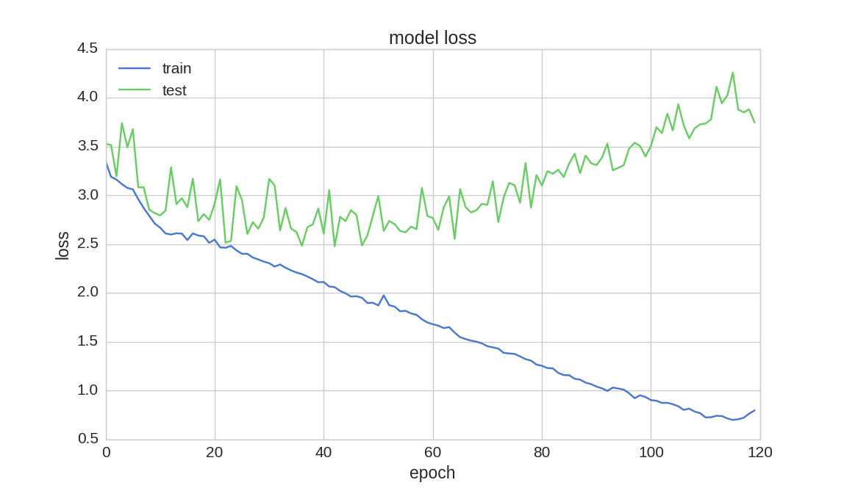
RNN using character approach:
First we trained by predicting character by character and achieved an accuracy of 78.57% over 120 epochs but then, this didn’t suit our application and results weren’t that satisfying

Slide 28
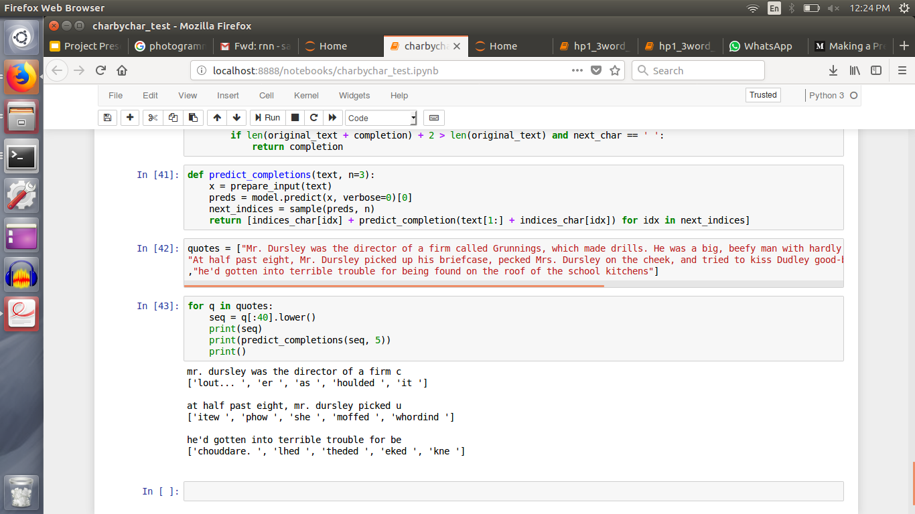
As we can see , here the results aren’t that pleasing when seen with the actual sentence in the quotes list

Slide 29
Results of LSTM for word by word:
Model Accuracy on Modi’s Speeches
after 150 epochs
Model Accuracies (Adam VS RMSprop)
for Harry Potter Novel after 120 epochs
Approach / Dataset | US Speech | GST Speech
3 Word approach | 87.28% | 80.33%
Whole sentence approach | 96.28% | 95.60%
Approach / Optimizer | Adam | RMSprop
3 Word approach | 56.44% | 37.74%

Slide 30
Epochs vs Accuracy/loss :

Slide 31
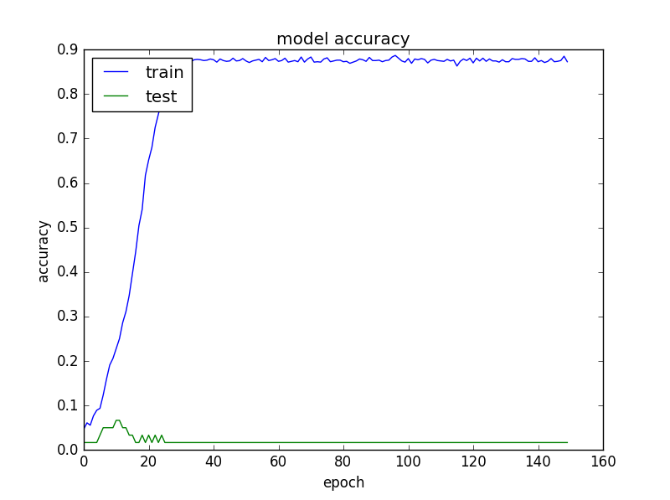
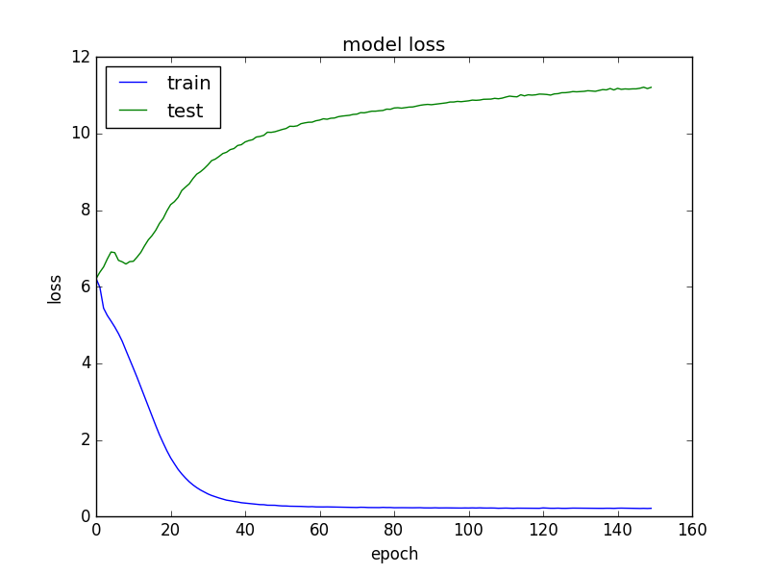
3 Word - US Speech

Slide 32
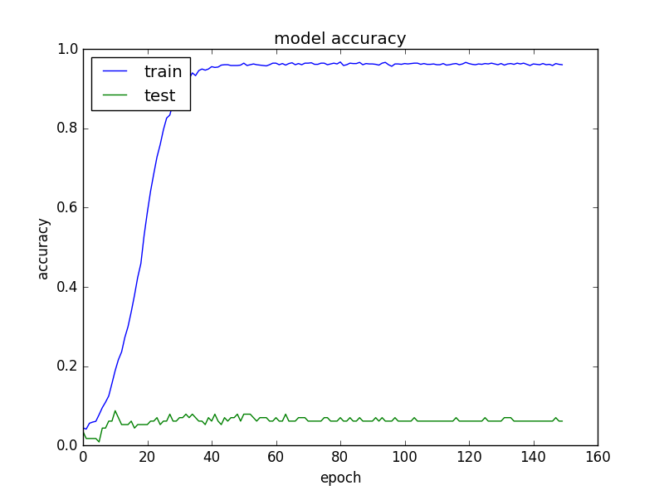
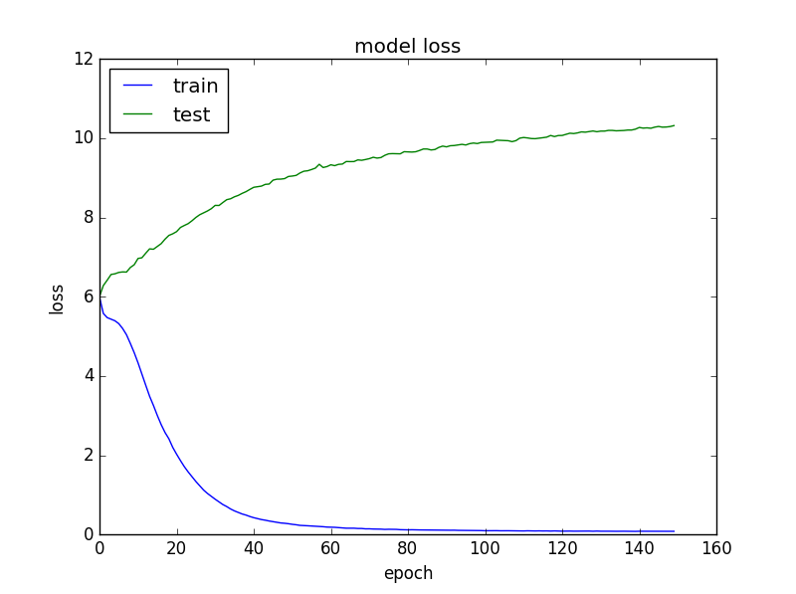
Sentence - US Speech

Slide 33
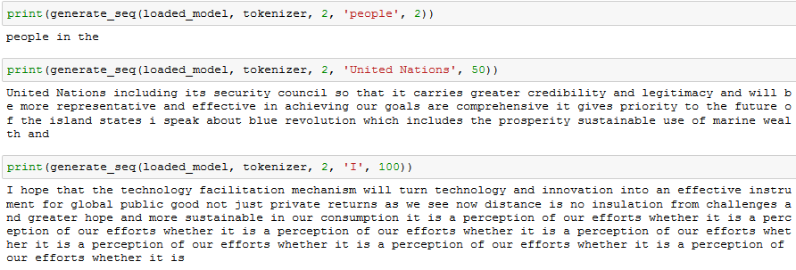
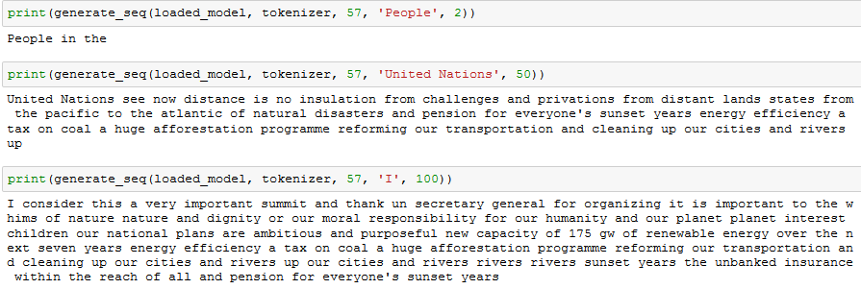
Fig: Predictions on 3 Word Model for US Speech
Fig: Predictions on Sentence Model for US Speech
We see that both the models have pretty much given a meaningful set of words as output. But the seentence approach is close the actual data but the three word trade off looks very meaningful too.

Slide 34
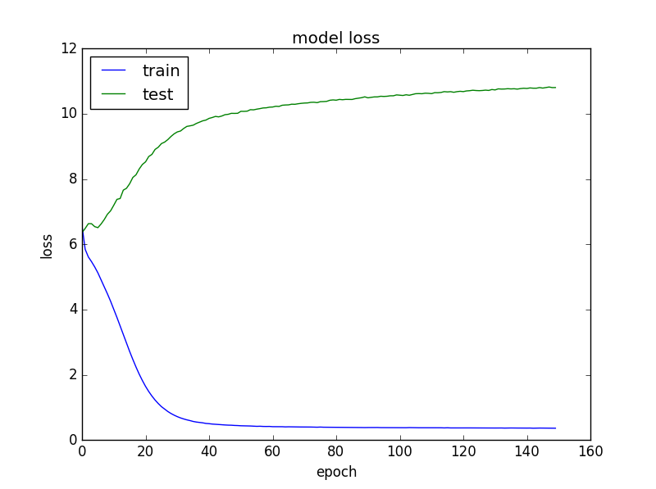
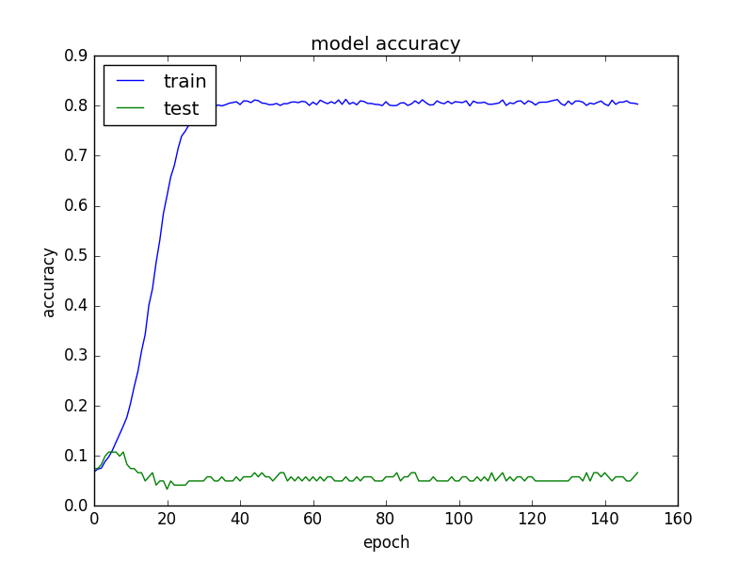
3 Word - GST

Slide 35
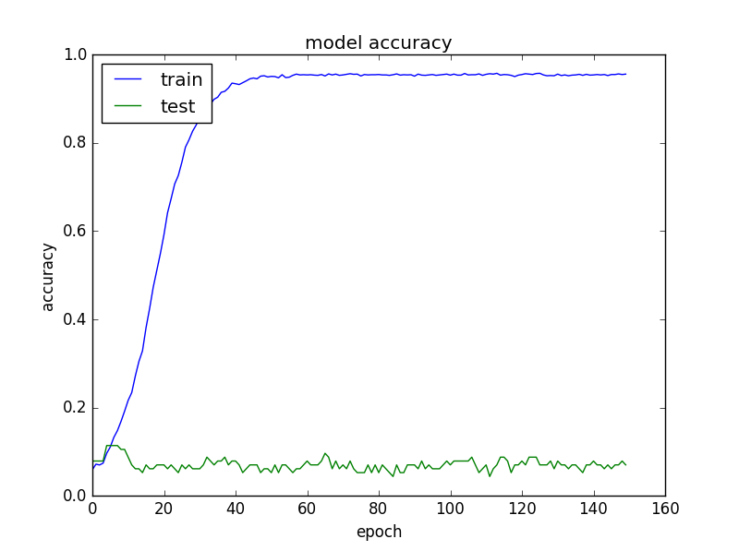
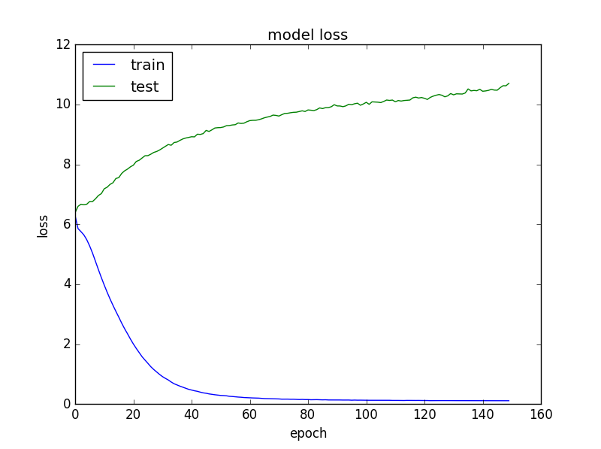
Sentence - GST

Slide 36
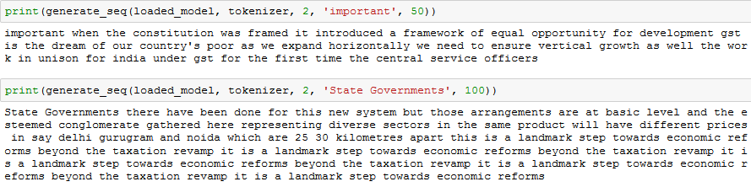
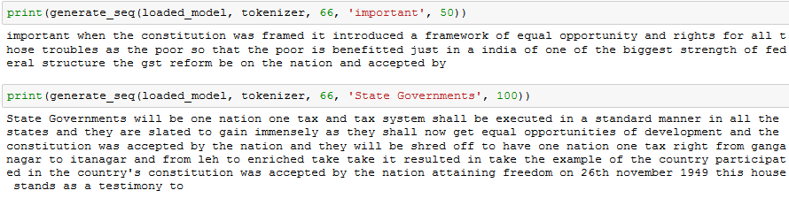
Fig: Predictions on 3 Word Model for Speech on GST
Fig: Predictions on Sentence Model for Speech on GST
Even here , we see that both the models have pretty much given a meaningful set of words as output. But the seentence approach is close the actual data but the three word trade off looks very meaningful too.

Slide 37
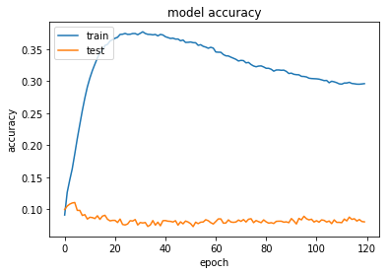
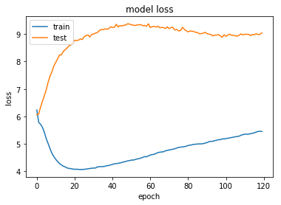
RMSprop V/s Adam for Harry Potter Novel
RMSprop optimization fetched an best accuracy of 37.74%

Slide 38
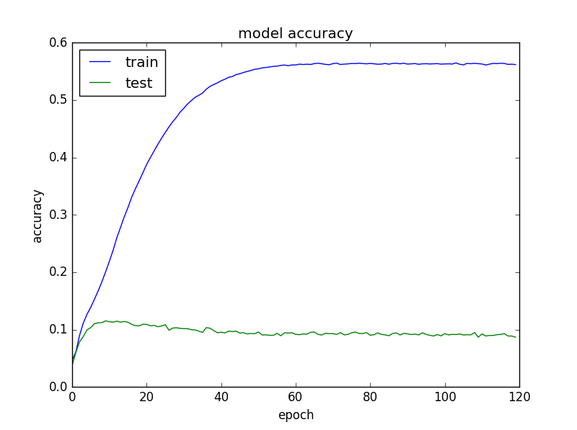
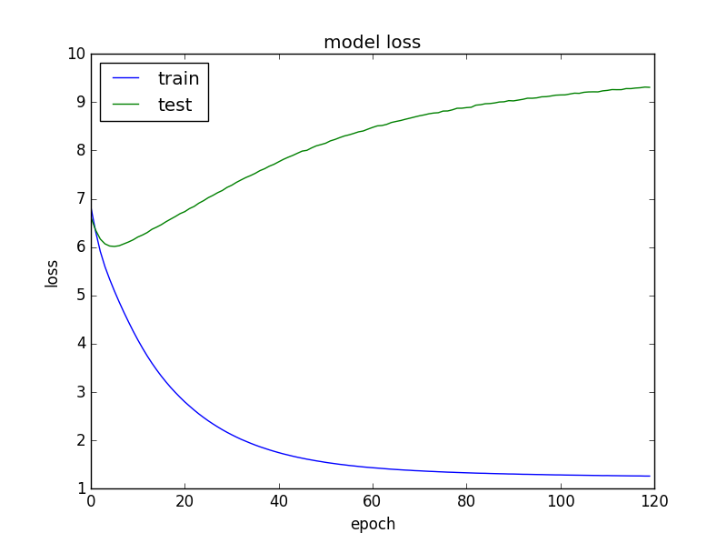
Adam fetched an accuracy of 56.44%, which even has a better validation accuracy when compared to RMSprop

Slide 39
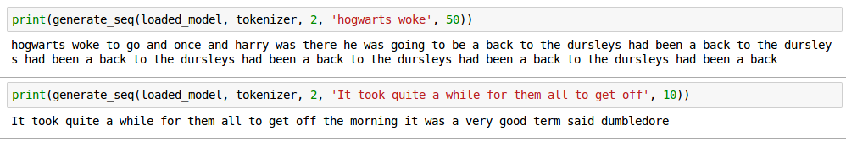
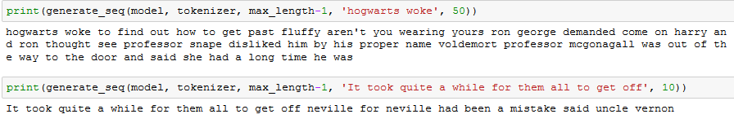
FIG: Test Outputs on Harry Potter Novel using RMSprop optimizer
FIG: Test Outputs on Harry Potter Novel using Adam optimizer
We can see clearly that adam optimization performed well than RMSprop which has repeated words, than adam which actually produced a paragraph with enough sense

Slide 40
Markov Chains V/s RNN
The RNN is more accurate than the n-gram model because it can retain more history than just the previous 2 tokens and using word vectors instead of discrete tokens for each word allows it to generalize and make predictions from similar words, not just exact matches.
The RNN takes longer to train (e.g. 8 hours vs 8 seconds, about 4000x longer), but would easily be able to fit into memory for applications like phone text entry - it also performs word predictions a bit slower than the n-gram, but not enough to be noticeable to an end-user.

Slide 41
Character by Character V/s Word by Word LSTM
As we can see that the outputs of word by word model were very very better than character by character.
And the training time is also less for the word by word model.
The two tradeoffs that is the sentence and the three word approaches in word by word models were compared in the previous slides accordingly to the dataset.

Slide 42
Training Times
Dataset/Approach | 3 word | Full sentence
US Speech | 2 secs/epoch (GEFORCE 920M) | 6 secs/epoch (GEFORCE 920M)
GST Speech | ~3 secs/epoch(GEFORCE 920M) | 18 secs/epoch(GEFORCE 920 M)
Dataset/Approach | 3 word/Adam | 3 word/RmsProp
HarryPotter | 250 secs/epoch (GEFORCE 860M) | 194 secs/epoch (GEFORCE 860M)

Slide 43
MILESTONES
Serial no | Milestone description | Status (% complete) | Comments
1 | Markov Chain | 100% | Was easy to implement
2 | Integrating SQL databases to Markov chain | 100% | Was a little tough to maintain the .db files but querying was very fast
3 | Writing a simple LSTM network | 100% | Initial results were bad
4 | Fine tuning the network | 80% | We could get accuracy above 90% for NM speech but validation accuracy is less around 15%. If no validation set is given then the results are very good .
5 | Have to train the network over large text like novels | 100% | We got around 60-70 % accuracy which has to be improved
6 | Fine tuning for large text | 80% | Still figuring out on the optimizers other than adam to improve the accuracy
7 | Dataset for Music compostions | - | Further Work
8 | Creating the application for keyboard and music generation - | - | Further work

Slide 44
TOP CHALLENGES UNRESOLVED SO FAR
Achieving accuracy above 75% over the large text corpus
Improving validation accuracy above 30 % for small text corpus
Training time isn’t reduced less than 260 sec per epoch on different batch sizes for large text corpus

Slide 45
OUR GOING FORWARD PLAN (OPTIONAL)
Step 1 : Creating better architectures to attain better validation accuracy
Step 2 : Making an keyboard application to android phones and Survey with people on how good this application is performing with their phones.
Step 3: Training the architecture on musical compostions of a particular singer and try to generate predictive musical notes which can uniquely represent his compositions.

Slide 46
OUR TOP THREE LEARNING IN THIS PROJECT
Learning # 1 : LSTM property to remember sequences and and produce the next output . This helped us a lot in creating better architectures.
Learning # 2 : Markov Chains to predict sequences with their unique property.
Learning # 3 : Working with different libraries like nltk , keras ,tensorflow, matplotlib ….

